Slide 1
RISK ASSESSMENT ADVICE

Slide 2
What is a Risk Assessment?
A Risk Assessment is simply a careful examination of what, in your work, could cause harm to people, so that you can weigh up whether you have taken enough precautions or should do more to prevent harm.
(Source – Health and Safety Executive HSE)

Slide 3
Why should we do Risk Assessments ?
Legal – requirement by law - under the Management of Health and Safety at Work Regulations 1999 and individual organisations health and safety policies
Financial – less chance of claims and prosecutions
Moral – Duty of care owed to all volunteers and others affected by our work

Slide 4
What information should a Risk Assessment include ?
Hazards (tangible things) and Risks (what could go wrong)
People at Risk (who might be harmed)
Control measures at present (have enough precautions been taken)
Further action required (should more be done)
Record details and keep the assessment under review
Source – HSE ‘5 steps to risk assessment’ guidance.
https://www.hse.gov.uk/simple-health-safety/risk/steps-needed-to-manage-risk.htm

Slide 5
Are there any standard Risk Assessments available to use ?
We have a template available.
See also: HSE https:/www.hse.gov.uk/simple-health-safety/risk/risk-assessment-template-and-examples.htm

Slide 6
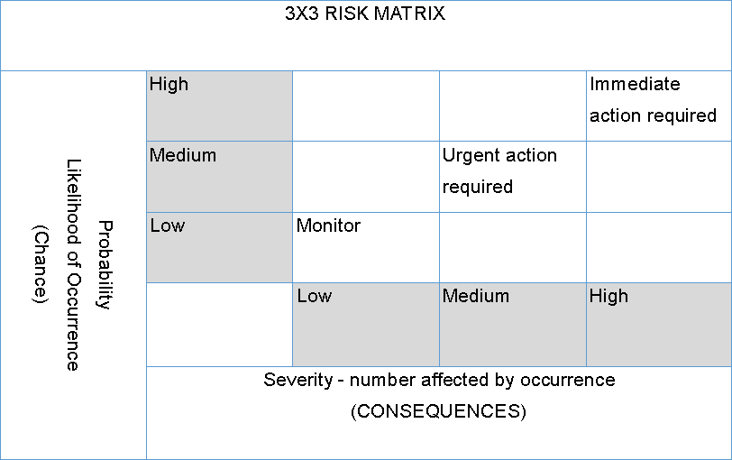
Level of Risk caused by Hazard(s)

Slide 8
What hazards and risks exist in and around events?
Examples of Hazards include:
Surface water or ice, potholes, hot water, sharp edges etc.
Risk management includes:
Safeguarding, supervision of the public and venue security
Handling, storage and transport of articles and substances
Using equipment
Using substances and solutions.
Using machinery

Slide 9
Who is responsible for doing the risk assessments ?
Your Organisations health and Safety policy will outline who is responsible for completing the risk assessments.
https://lionsclubs.co/MemberArea/wp-content/uploads/Health-and-Safety-Guidance-for-Lions-May-2023.pdf
Club Health and Safety Officer or President must ensure a risk assessment is done before the event takes place.
Attitudes to risk vary greatly between individuals so a group or team approach as opposed to an individual approach is better when assessing risk and establishing safe working practises. Different people might notice different hazards. Control measures should be agreed and notified to participants.

Slide 10
Eliminate Risk or Reduce Risk
Identification of hazards is essential: Hazards are the source of risk
Control measures must be appropriate and effective
https://www.haspod.com/blog/paperwork/5-best-risk-assessment-control-measures

Slide 12
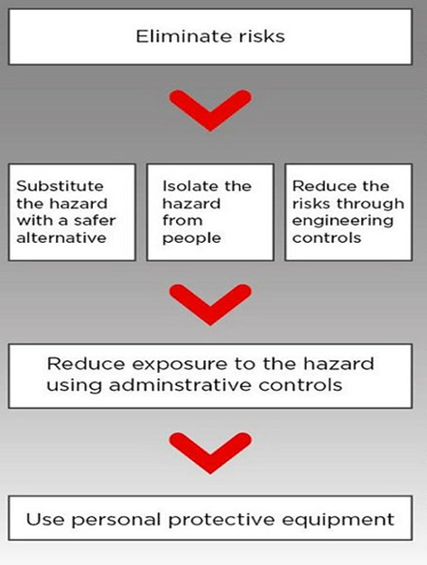

Slide 13
How often should risk assessments be reviewed ?
The law requires that risk assessments should be reviewed periodically, it is up to the Lions club to decide on frequency.
Risk assessments are dynamic and should be amended with changing circumstances, once you discover that something isn’t right, rectify it.
Best practise is that risk assessments are reviewed after every event to update and identify hazards, risks and control measures, not previously considered.
In the event of injury or damage occurring at an event the effectiveness of the risk assessment will be investigated.

Slide 14
Where can we get advice from ?
Health and Safety Officer : hso@lions105cw.org.uk
MD Health and Safety Officer : lionandrewwilcox@btinternet.com
Headquarters Staff : enquiries@lionsclubs.co
Insurance Company: Gallaghers
Health and Safety Executive : https://www.hse.gov.uk/
https://lionsclubs.co/MemberArea/wp-content/uploads/2023-24-Lions-Clubs-British-Isles-Health-and-Safety-Policy-as-at-July-2023.pdf
https://lionsclubs.co/MemberArea/wp-content/uploads/Health-and-Safety-Guidance-for-Lions-May-2023.pdf

Slide 15
Reference
Model risk assessments available from local councils
HSE guidance
HSG65 - file:///C:/Users/Admin/Downloads/hsg65(1).pdf
Lion’s policies and procedures
Safety Culture - https://safetyculture.com/topics/workplace-hazards/5 Levels of Hazard Control Measures | SafetyCulture

