Slide 1
Public Relations & Marketing
Lion Sophie Moseley

Slide 2
What is marketing and public relations?
Marketing: the action or business of promoting and selling products or services, including market research and advertising.
Public Relations: the professional maintenance of a favourable public image by a company or other organisation or a famous person. The state of the relationship between a company or other organisation or a famous person and the public
- Google Dictionary 2021

Slide 3
Why is it important?

Slide 4
Brand Awareness & working with the Community

Slide 5
Public view
Secret
Old fashioned
Not fun
Push another image
Get the word out there
Change perceptions
Remember the brand

Slide 6
The importance of looking alike
Why do we need to look alike?
how do we do this?
We are all from the same organisation
To make the brand bigger and better
To ensure the public knows the brand
Using the correct logo
Using professional printing
Using the correct imagery

Slide 7
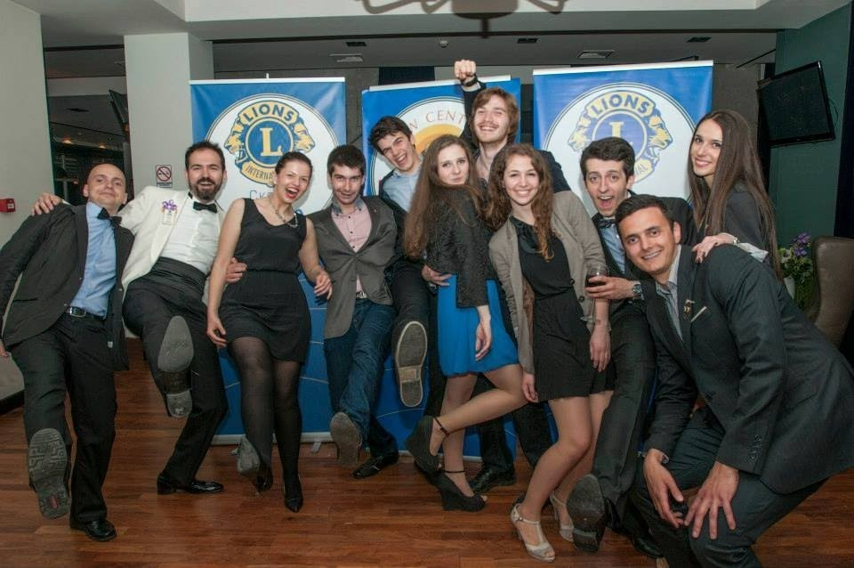
The importance of looking alike

Slide 8
Your audience
Who is your audience?
What is it that you are trying to promote?
When?
Where?
Why should the audience get involved?
How do they get involved?
#TeamCW

Slide 9
Event: Litter pick
5 W’s & 1 H
Audience
Who
What
When
Where
Why
How
Everyone
The litter pick
Date – 12th September 2021
Local park
To clean up the area
Contact details

Slide 10
Building Relationships
Assess the community – Needs vs Wants
Ambassador
Contact local businesses, charities and volunteers
Meet up with them in person
Talking and asking questions
Offering them something in return
Paper trail
Follow up
Thank you
#TeamCW

Slide 11
The importance of evaluation
What has worked?
What needs to be adjusted to have more success?
Trial case studies
Show your success
#TeamCW

Slide 12
Domino Effect

Slide 13
Accessibility
Clear
Correct
Professional
Easy to Access
3 Clicks Away
30 Second rule
#TeamCW

Slide 14
Sales Formula (Increasing membership)
Awareness
Traffic
Optimisation
Sales
Sentiment
#TeamCW

Slide 15
4 Types of Content
Entry level Content
Category Content
Community Content
Product and Scale
#TeamCW

Slide 16
Hash Tags
#Membershipmonday
#Throwbackthursday
#ServiceSaturday
#FunFriday
Ones we use regularly: # WeServe #kindnessmatters #TeamCW #LionsGetInvolved
For the 5 pillars of service:
#environment #diabetes #sight / #vision #hunger #foodbank #childhoodcancer
#TeamCW

Slide 17
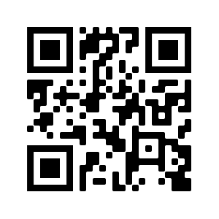
QR Codes
A QR code is a type of matrix barcode
Scan via the camera on your smart phone

Slide 18
Useful Tools
Technical
Canva
Layout App
Publisher
Practical
Business cards
Bookmarks
Flyers
Press releases
Social media & Websites

Slide 19
Remember…
Notes:
You are only as good as your last post

Slide 20
Thank you Q & A

